Slide 1

FRUITS AND VEGETABLES PREDICTOR
By : Sowmiya S 210701255
Sreena R 210701256

Slide 2
1
ABSTRACT
In recent years, the integration of machine learning techniques, particularly Convolutional Neural Networks (CNNs), has revolutionized various fields including image recognition and classification. The proposed system utilizes a dataset comprising diverse images of fruits and vegetables obtained from various sources. Subsequently, a CNN architecture is designed and trained on the preprocessed dataset to learn discriminative features representative of different fruits and vegetables. Furthermore, the model exhibits resilience to variations in lighting conditions, background clutter, and occlusions. The proposed fruit and vegetable predictor holds significant potential for applications in agriculture, food industry, and dietary analysis, facilitating automated classification and quality assessment processes.

Slide 3
2
INTRODUCTION
In a world increasingly reliant on automation and data-driven decision-making, the accurate identification and classification of fruits and vegetables play a pivotal role across various sectors such as agriculture, food industry, and dietary analysis. Leveraging the power of Convolutional Neural Networks (CNNs), this project aims to develop a robust Fruit and Vegetable Predictor. By utilizing a diverse dataset and advanced CNN architecture, our goal is to create a system capable of accurately recognizing different types of fruits and vegetables from input images, thus streamlining processes and enhancing productivity in relevant industries.

Slide 4
DEEP LEARNING
3
Deep learning is a subfield of machine learning that focuses on algorithms inspired by the structure and function of the human brain's neural networks. It involves training artificial neural networks, particularly deep neural networks with multiple layers, to learn representations of data through hierarchical abstraction.
Types of Deep Learning
Feedforward Neural Networks (FNNs)
Convolutional Neural Networks (CNNs)
Recurrent Neural Networks (RNNs)
Long Short-Term Memory Networks (LSTMs) and Gated Recurrent Units (GRUs)
Autoencoders
Generative Adversarial Networks (GANs)

Slide 5
CONVOLUTIONAL NEURAL NETWORKS (CNNS)
4
Convolutional Neural Networks (CNNs) are a class of deep neural networks designed primarily for analyzing visual imagery. CNNs consist of multiple layers, including
Convolutional Layers
Pooling Layers
Flatten layer
Fully Connected Layers

Slide 6
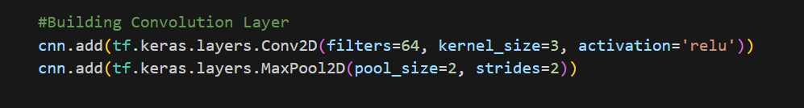
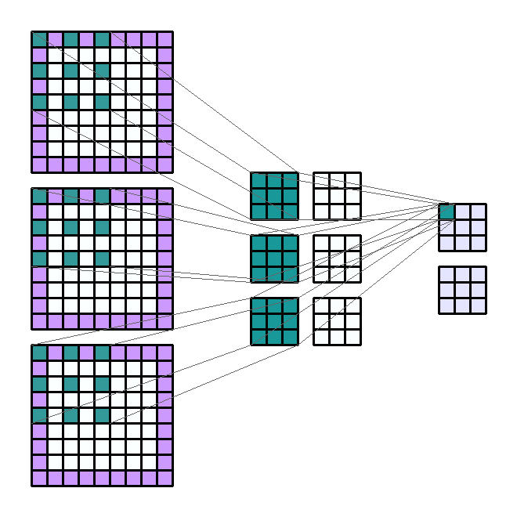
5
CONVOLUTIONAL LAYER
tf.keras.layers.Conv2D(): This creates a 2D convolutional layer using the Keras API. Convolutional layers are fundamental building blocks of CNNs, responsible for learning spatial hierarchies of patterns in the input data.

Slide 7
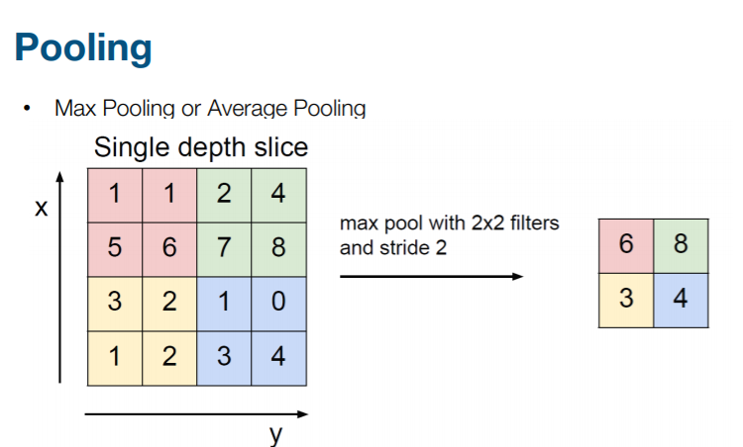
6
POOLING LAYER
tf.keras.layers.MaxPool2D(): This creates a 2D max pooling layer. Max pooling is a downsampling operation that reduces the spatial dimensions of the input data while preserving the most important features.

Slide 8

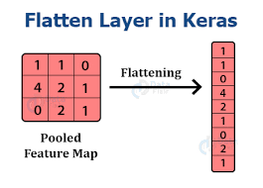
7
FLATTEN LAYER
tf.keras.layers.Flatten(): This creates a flatten layer. The purpose of the flatten layer is to reshape the output of the preceding convolutional or pooling layers into a one-dimensional vector expect input data in a one-dimensional format.

Slide 9
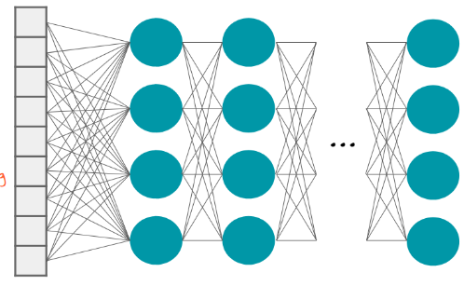
9
DENSE LAYER
tf.keras.layers.Dense(): This creates a dense layer. Dense layers are fully connected layers in which each neuron is connected to every neuron in the previous layer.

Slide 10
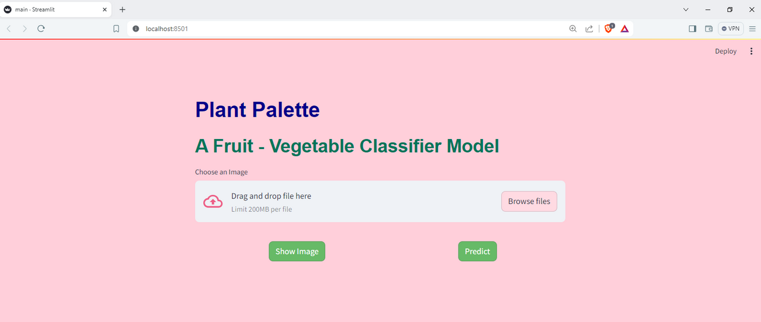
10
STREAMLIT
1
A popular Python library used for creating interactive web applications for data science and machine learning projects.
2
You can create interactive components like sliders, dropdown menus, and plots, and Streamlit will automatically update the app in real-time as you modify your code.

Slide 11
THANK YOU

